Slide 1
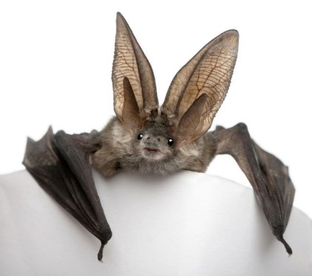
Rabies Updates Environmental Health Directors Oct 2018
Kelly H. Giesbrecht, DVM, MPH
KY State Public Health Veterinarian

Slide 2
Agenda
Rabies in KY
2017 & 2018 Cases
Vaccination Clinic Regulation Updates
Quarantine Regulations

Slide 3
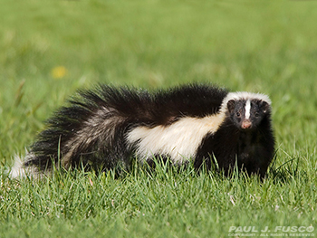
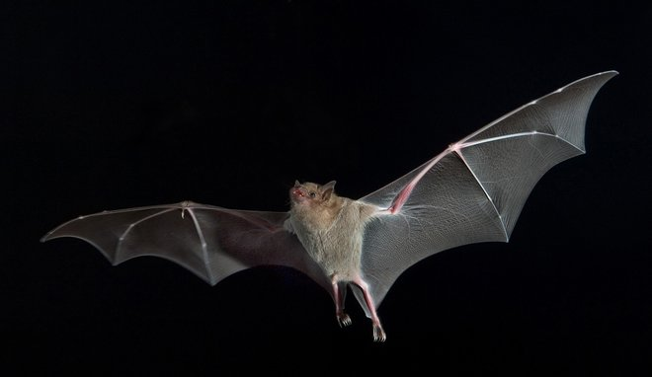
Rabies in Kentucky
Terrestrial:
Skunk Variant
Bat Variant
So are these the only animals in Kentucky that can transmit rabies?

Slide 4
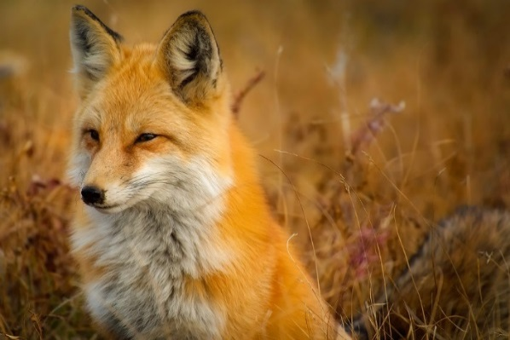
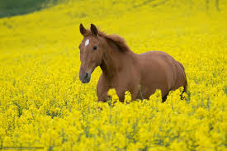
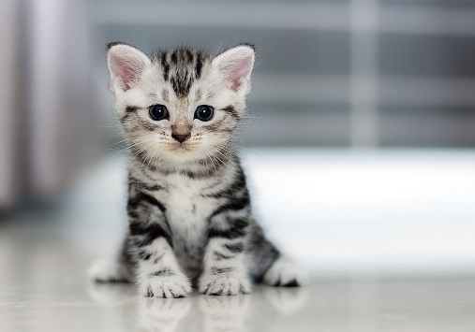
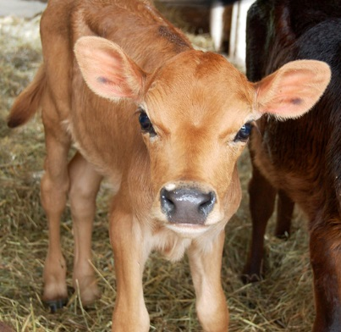
Other Rabid Animals Seen in Kentucky
Fox: 2018
Cattle: 2017
Dog: 2017
Cat: 2016
Raccoon (1991)
Horse (2015)
Rat (1989)
Goat (2002)

Slide 5
10 Years: Oct 2007-Oct 2017 Positive Rabies in KY

Slide 6
2017 Positive Rabies KY

Slide 7
Animal Rabies Cases- 2017
1/3/2017 | 1 | Skunk | Barren | KY DPH
1/26/2017 | 1 | Skunk | Butler | KY DPH
1/26/2017 | 1 | Dog | Clinton | KY DPH
1/27/2017 | 1 | Cattle | Warren | KY DPH
3/1/2017 | 1 | Skunk | Todd | KY DPH
4/3/2017 | 1 | Skunk | Clinton | KY DPH
6/13/2017 | 1 | Bat | Oldham | KY DPH
6/20/2017 | 1 | Bat | Fayette | KY DPH
10/2/2017 | 1 | Bat | Daviess | KY DPH
10/20/2017 | 1 | Bat | Jefferson | KY DPH

Slide 8
2018 Positive Rabies by Month

Slide 9
2018 Positive Rabies by County

Slide 10
2018 Positive Rabies
UKVDL Rabies Map
2018 Cases

Slide 11
Information…
Go To UKVDL
Rabies Map:
Kentucky Rabies Tests
On the horizon…
Bat Bytes…
Quarterly Rabies Updates

Slide 12
Canine Head for Rabies Testing

Slide 13
Canine Brainstem for Rabies Testing

Slide 14
Bat for Rabies Testing

Slide 15
Bat Brain

Slide 16
Brain Removed

Slide 17
Rabies Clinics
Rabies Vaccination laws
Kentucky Revised Statute 258
Kentucky Administration Reg 2:070
Dogs, cats and ferrets:
Vaccinate by 4 months
Revaccinate 1 year later
Booster according to vaccine
(1 or 3 year)
Certification for owners
Can vaccinate horse, cattle

Slide 18
Rabies Vaccination Clinics
KRS 258.043 Mass Immunization Clinics
Local Health Departments can sponsor mass immunization clinics for rabies vaccination
Cost cannot exceed $5 to help defray the cost of the clinic: Ends July 1, 2019
902 KAR 2:070 Rabies Control
Three year vaccines shall be used in mass immunization clinics sponsored by local health departments

Slide 19
$5.00 Cap
Removed starting July 1, 2019 HB 327
Set in 1978, 40 years old
Veterinarians complain they lose money due to personnel costs
Limits the number of clinics being offered
Create a flexible and fair solution
6% Tax added to $5.00

Slide 20
Management of Animal Quarantine: Animals Biting Humans
10 Days: Dogs, cats, ferrets
Re-Vaccinate at end of 10 days
Livestock: Varies, call for consult
Wildlife: Euthanize & Test
Animals that get ill or die during quarantine: Test

Slide 21
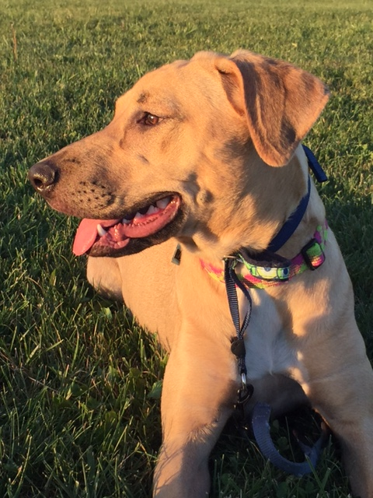
Animal Bites (to humans)
PHYSICIANS ARE REQUIRED TO REPORT TO LHD (WITHIN 12 HOURS OF TREATMENT OR NEXT WORKING DAY)
IF NOT TREATED, PARENT OR GUARDIAN REQUIRED TO REPORT
LHD DESIGNATES QUARANTINE SITE (10 - 180 DAYS AT OWNERS EXPENSE)
PET OWNER RESPONSIBLE for COST of
QUARANTINE or test, DAMAGES, AND/OR PEP

Slide 22
MANAGEMENT OF ANIMALS bitten by (possibly) RABID animals
VACCINATED DOGS, CATS & FERETS -
REVACCINATE, QUARANTINE & OBSERVE 45 DAYS
UNVACCINATED DOGS, CATS & FERRETS –
EUTHANIZE
ALTERNATIVE -STRICT QUARANTINE:
Dogs & Cats: 4 months
Ferrets: 6 months
VACCINATE IMMEDIATELY (within 96 hours)
Consider increasing quarantine to 6 month
OTHERS – Consult with KDPH
ISOLATE & HANDLE WITH CARE FOR 180 DAYS
May be changed in Reg to KY Dept of Agriculture to administer quarantine in livestock

Slide 23
Quarantine
Dog Bites Man:
Quarantine 10 days
Vaccinate at END of quarantine
Wildlife bites Dog:
Vaccinate at Start of quarantine
Quarantine:
45 days if current on vacc’s
Not vaccinated:
Euthanize
Vaccinate & 4-6 month quarantine
Overdue on Vacc:
Vaccinate: 45 day-6 month

Slide 24
Human PEP Indications: Urgent NOT Emergency
Exposure
Broken Skin to saliva
Saliva on mucus membrane
Animal Tests Positive
Unable to observe or test animal
Bite was unprovoked
Exceptions: Small rodents, lagomorphs

Slide 25
Bats are cryptic biters
Bite may not be felt or seen
Bite after a bat brushed by
Last Human Death due to Rabies in Kentucky: 1996 (Bat)
Notes:
Tell story of cat with bat attached to it

Slide 26
Rabies PEP: Urgent not Emergency
Unvaccinated:
1. HRIG (Immediate, passive) around wound
2. Rabies vaccine in deltoid
0
3
7
14
28 Immunocompromised)
Days
Previously Vaccinated
NO HRIG
2 doses Rabies vaccine in deltoid
0
3
Days

Slide 27
Final Thoughts: Don’t think of bats like this…
Notes:
Batman joke

Slide 28
They are cute & cuddly! Questions?

Slide 29
Questions?
Kelly Giesbrecht, DVM, MPH
State Public Health Veterinarian
502-564-3418x4313
Kelly.Giesbrecht@ky.gov

